Slide 1
What are Selectors?
A Selector in UiPath Studio is a feature that enables the identification of the User Interface elements through its address and attributes stored as XML fragments.
The element identification is done to perform specific activities in an automation project. Selectors are generated automatically every time we use an activity that interacts with graphical user interface elements.
In order for the postman to deliver the letters, a specific path is required and must contain structured and hierarchized details such as Country > City > Zip Code > Street Name > Street Number > Apartment Number. Similarly, UiPath Studio requires the detailed path to a specific element within the user interface.

Slide 2
Tags & Attributes of Selectors
Tags
Nodes in the selector XML fragment
Correspond to a visual element on the screen
First node is the app window
Last node is the element itself
For example:
wnd (window)
html (web page)
ctrl (control)
webctrl (web page control)
java (Java application control)
Attributes
Every attribute has a name and a value. You should use only attributes with constant or known values
For example:
parentid=‘slide-list-container’
tag=‘A’
aaname=‘Details’
class=‘btn-dwnl’

Slide 3
The UiExplorer
The UI Explorer is the functionality in UiPath Studio that allows analyzing and editing selectors. It contains a status button showing users the state of the selector, a Visual Tree Panel that displays a navigable UI of each application running at that moment, as well as the selected UI element. The UI Explorer displays all the available tags and attributes and gives the option to check them in or out.
Type of Selectors
Full Selector
Partial Seletor

Slide 4
When are partial or full selectors used?
The best example of using a Partial Selector would be a simple automation where the deployed workflow only performs actions in the same application without shifting through multiple windows like a simple CRM.
On the other hand if the workflow would be required to interact with multiple windows like the same CRM and a document, which would make the UI elements required in this particular example dispersed in multiple windows, a Full Selector would be required.

Slide 5
Practice 1 - Get and Sort Data
Create a workflow that generates 10 fake names along with their details and then sorts them in an excel file that will be organized in 5 columns namely: Name, Phone, Birth-date, Email-Address and City, State, Zip. After sorting all the details, the workflow should continue to save the excel file in a specified folder.
Notes:
Use the www.fakepersongenerator.com site to generate the 10 fake names along with their details
All selectors must not contain idx attributes.
All of the activities starting with the first record generation to the last activity which is saving the excel file in a specific folder should be processed in one workflow execution.

Slide 6
Practice 2 - Set Data
Create a workflow that fills in the fields of a website with organized data that will be taken from an Excel file provided herein. It contains the following data: CompanyName, RoleInCompany, Address, Email, FullName, PhoneNumber.
Web :http://rpachallenge.com/
Notes:
The first and last name has to be obtained form the full name column of the excel file.
Use only anchor-based selectors for this exercise.

Slide 7
Practice 3 - Highlight WFT Type Items on ACME
Create a workflow that can highlight each specific type of workflow on the ACME Test website (www.acme-test.com).
Notes:
You will need an ACME account for this exercise. If you don’t have it, make sure you create it
Before starting the exercise, make sure you go to User Options and Reset Test Data.
Give the user the option to choose between the WI1, WI2, WI3, WI4 and WI5 types of workflows

Slide 8
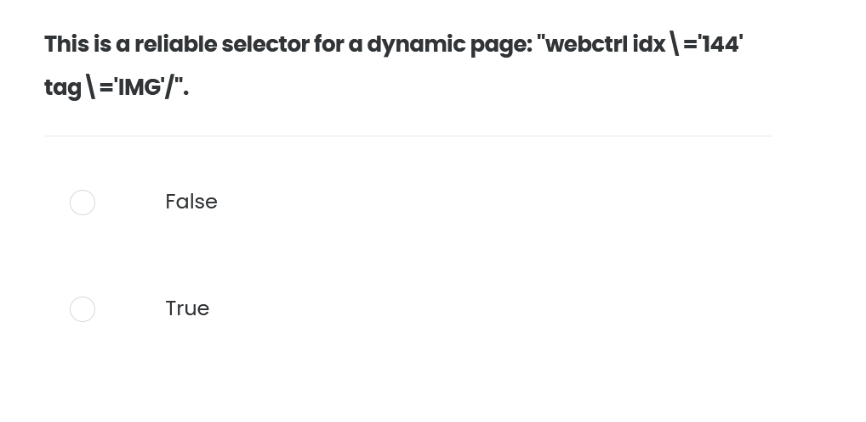
Quiz 01/10

Slide 9
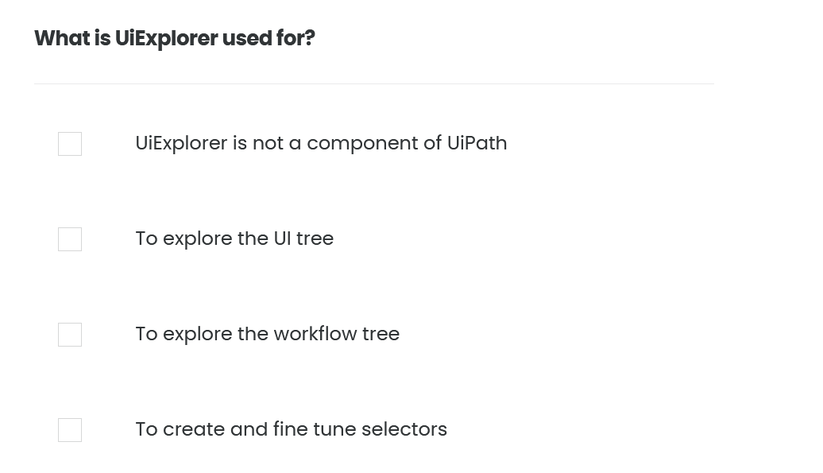
Quiz 02/10

Slide 10
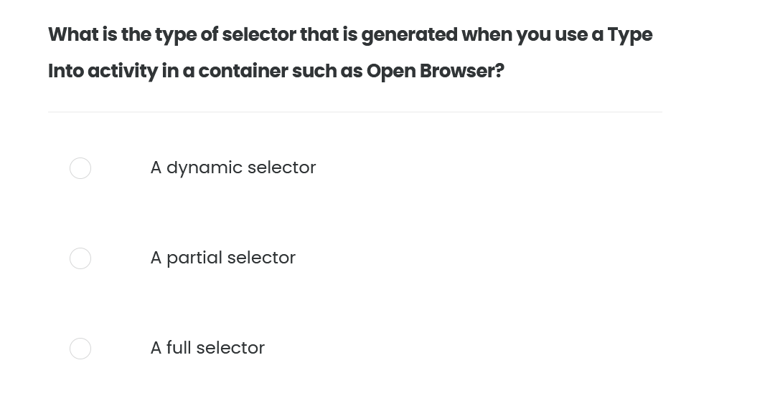
Quiz 03/10

Slide 11
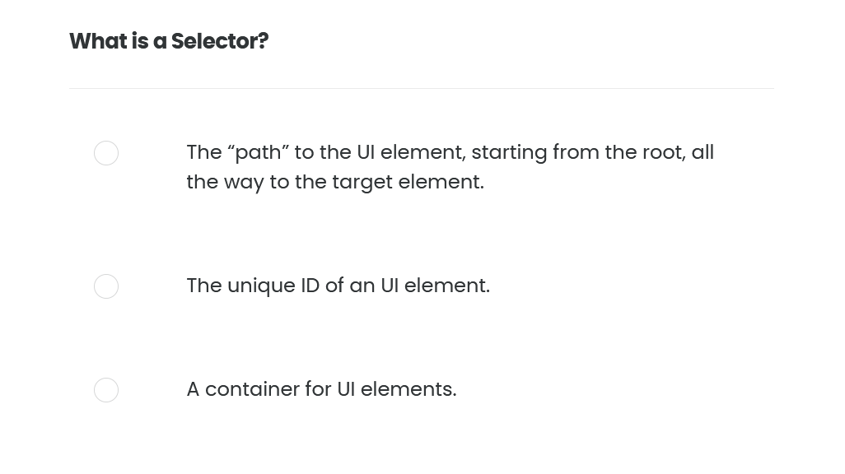
Quiz 04/10

Slide 12
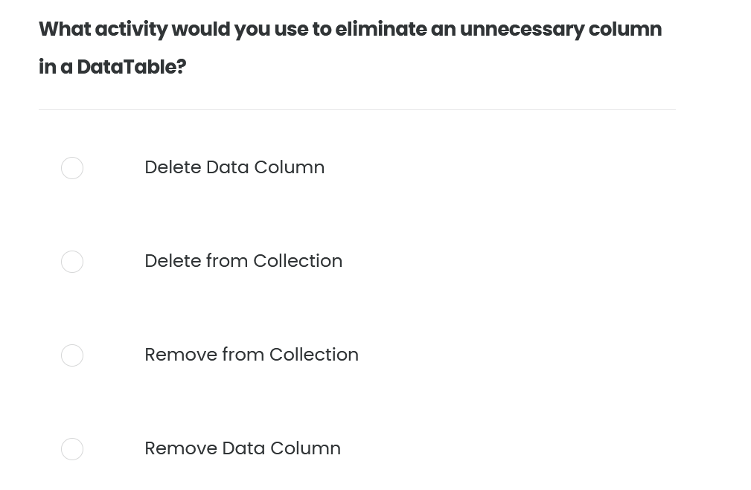
Quiz 05/10

Slide 13
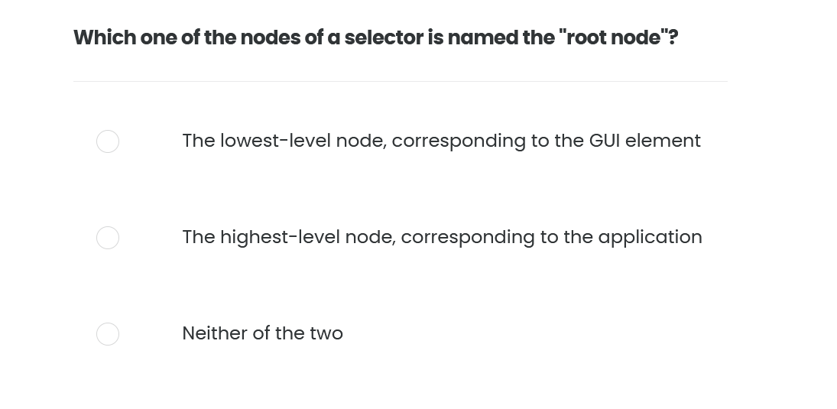
Quiz 06/10

Slide 14
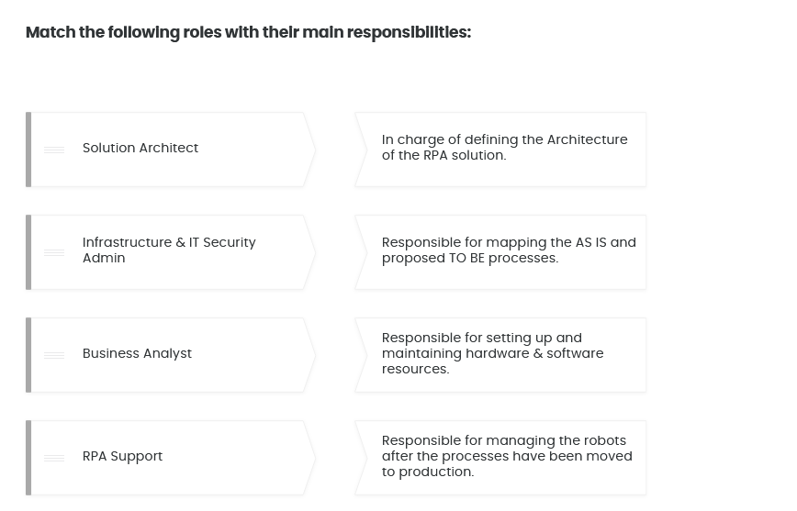
Quiz 07/10

Slide 15
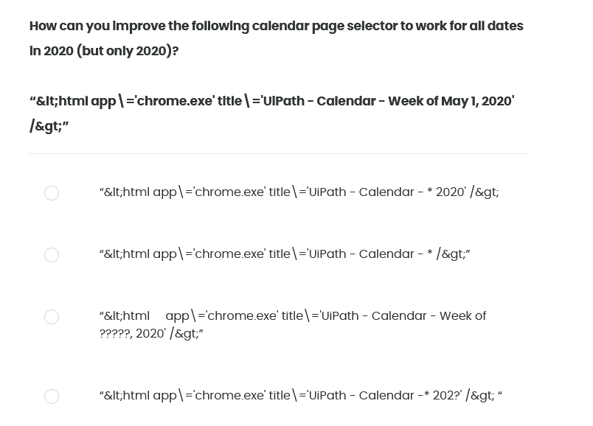
Quiz 08/10

Slide 16
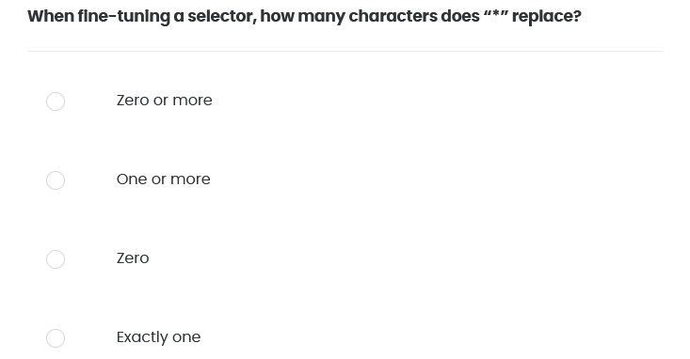
Quiz 09/10

Slide 17
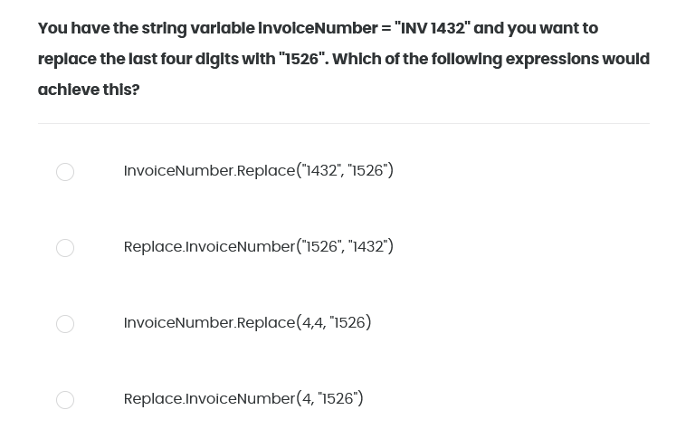
Quiz 10/10

